Slide 1

Decision Trees: A Visual Guide to Decision Making
Decision trees are simple diagrams that show different choices and their possible results, helping you make decisions easily. They provide a visual representation of options for solving problems and show how different factors are related.
Muhammad Saeed

Slide 2
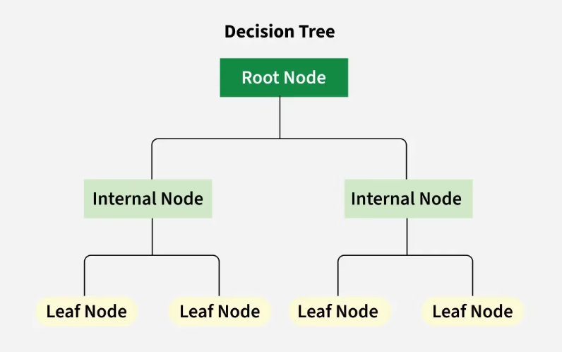
Understanding Decision Trees
Key Components
A decision tree has a hierarchical structure that starts with one main question at the top called a node, which branches out into different possible outcomes.
Root Node: The starting point representing the entire dataset
Branches: Lines connecting nodes, showing flow from one decision to another
Internal Nodes: Points where decisions are made based on input features
Decision trees support decision-making by visualizing outcomes. You can quickly evaluate and compare the "branches" to determine which course of action is best for your situation.
Leaf Nodes: Terminal nodes representing final outcomes or predictions

Slide 3


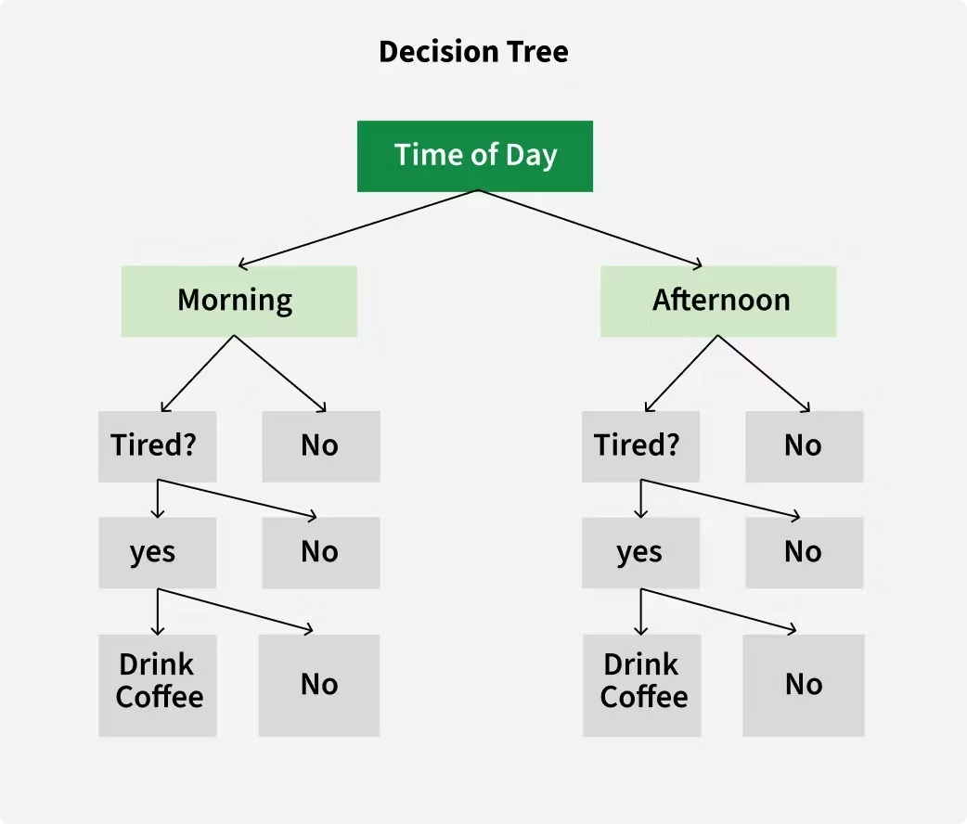



Decision Tree Example
Time of Day Check
First, the tree checks the time of day—morning or afternoon
Tiredness Assessment
Next, it asks whether you are tired
Decision Making
Based on these factors, it recommends whether to drink coffee
Final Outcome
The leaf node provides the final recommendation: coffee or no coffee

Slide 4
Types of Decision Trees
Classification Trees
Regression Trees
Designed to predict categorical outcomes, these trees classify data into different classes. For example, they can determine whether an email is "spam" or "not spam" based on various features of the email.
Used when the target variable is continuous, these trees predict numerical values rather than categories. For instance, a regression tree can estimate the price of a house based on its size, location, and other features.

Slide 5
How Decision Trees Work
Reaching the Outcome
Sequential Decision Making
Branching Process
You eventually reach the end of a branch where you find the final outcome or decision. This could be a classification (like "spam" or "not spam") or a prediction (such as an estimated price).
Root Node Creation
From the root node, the tree asks a series of yes/no questions. Each question splits the data into subsets based on specific attributes. For example, if the first question is "Is it raining?", your answer determines which branch to follow.
This branching continues through a sequence of decisions. As you follow each branch, you encounter more questions that break the data into smaller groups until no more helpful questions remain.
A decision tree starts with a main question known as the root node. This question is derived from the features of the dataset and serves as the starting point for decision-making.

Slide 6




Advantages of Decision Trees
Simplicity and Interpretability
Versatility
Decision trees are straightforward and easy to understand. You can visualize them like a flowchart, which makes it simple to see how decisions are made.
They can be used for different types of tasks and work well for both classification and regression problems, making them adaptable to various scenarios.
No Need for Feature Scaling
Handles Non-linear Relationships
Unlike many other algorithms, decision trees don't require you to normalize or scale your data, simplifying the preprocessing steps.
They are capable of capturing non-linear relationships between features and target variables, making them effective for complex data patterns.

Slide 7






Disadvantages of Decision Trees
Instability
Decision trees can be unreliable as slight variations in input can lead to significant differences in predictions.
Overfitting
Overfitting occurs when a decision tree captures noise and details in the training data, causing it to perform poorly on new data.
Bias Towards Features with More Levels
Trees can become biased towards features with many categories, focusing too much on them during decision-making and potentially missing other important features.

Slide 8



Banking Application: Loan Approval
Customer Profile Analysis
Evaluate applicant's income, credit score, and employment status
Loan History Assessment
Review past loan repayment behavior and existing debt
Risk Evaluation
Determine approval or rejection based on calculated risk
Banks use decision trees to streamline the loan approval process. By inputting customer data like income, credit score, employment status, and loan history, the decision tree can quickly predict whether to approve or reject a loan application. This helps banks make consistent, data-driven decisions while reducing the time needed for manual review.

Slide 9





Healthcare Application: Medical Diagnosis
Clinical Test Results
Collect patient data including glucose levels, BMI, and blood pressure
Data Analysis
Process patient information through the decision tree algorithm
Diagnostic Classification
Classify patients as diabetic or non-diabetic based on the analysis
Treatment Planning
Develop appropriate treatment plans based on the diagnosis
In healthcare, decision trees assist doctors in diagnosing conditions like diabetes. By analyzing clinical test results such as glucose levels, BMI, and blood pressure, the decision tree can classify patients into diabetic or non-diabetic categories with high accuracy. This tool serves as a valuable support system for healthcare providers, helping them make more informed diagnostic decisions.

Slide 10








Education Application: Predicting Student Performance
Academic Success
Passing exam results
Study Habits
Time spent studying and consistency
Attendance
Regular class participation
Previous Performance
Past academic achievements
Schools can use decision trees to predict whether students will pass or fail exams based on their study habits. By analyzing data such as attendance records, time spent studying, and previous grades, the decision tree identifies at-risk students who might need additional support. This early identification allows teachers to intervene proactively, providing targeted assistance to help students succeed.

Slide 11




Retail Application: Customer Segmentation
Purchase History
Demographics
Loyalty Status
Targeted Marketing
Customer age, location, income level, and other personal attributes
Duration of customer relationship and engagement with loyalty programs
Analysis of past buying behavior, frequency, and product categories
Personalized promotions based on customer segment classification
Retailers use decision trees to segment customers into different groups based on their shopping behaviors. By analyzing purchase history, demographics, and loyalty status, businesses can classify customers into segments like "high-value," "occasional," or "at-risk of churning." This segmentation enables retailers to create targeted marketing campaigns and personalized offers that resonate with each customer group.

Slide 12










Decision Tree Implementation Process
Data Splitting
Data Collection
Divide data into training and testing sets
Gather relevant data with features and target variables
Tree Construction
Build the decision tree using the training data
Optimization
Prune and refine the tree to improve accuracy
Model Evaluation
Test the model's performance on unseen data
Implementing a decision tree involves a systematic process that begins with collecting relevant data containing features and target variables. After splitting this data into training and testing sets, the algorithm constructs the tree using the training data. The model is then evaluated on the testing data to assess its performance. Finally, optimization techniques like pruning are applied to refine the tree and improve its accuracy on new data.

